Slide 1
Sentiment Analysis of Product Reviews of Online Shop
Presented By
Md. Jahedul Alam Rifat
ID: 1604121
Supervised By
Animesh Chandra Roy
Assistant Professor
Dept. of CSE, CUET

Slide 2
Contents
Introduction
Motivation
Previous Work
Objectives
Proposed System
Conclusion
References

Slide 3


Introduction
Online Shopping becoming very popular
Online buyers,
Some find the perfect product
Other gets a product being damaged
tend to share experiences through review and comments
Millions of reviews being generated daily
For a new buyer
Difficult to go through every reviews
Summary might help

Slide 4
Motivation
To avoid reading boring reviews
To provide buyers a trusted feedback
To help the seller improving his services

Slide 5
Previous Work
[Jagdale et al.,2019][1]
Compared two ML approaches - Naïve Bayes and SVM
Dataset contained 4783 negative and 2006 positive words
NB got 98.17% , SVM got 93.54% accuracy
Limitation:
Used only two types of word
Comparatively low quantity dataset
Reference
[1] R. S. Jagdale, V. S. Shirsat and S. N. Deshmukh, ‘Sentiment analysis on
product reviews using machine learning techniques,’ in Cognitive Informatics and Soft Computing, Springer, 2019, pp. 639–647

Slide 6
Previous Work
[LI Yang et al.,2020][2]
Had over 100,000 reviews
Applied Deep Learning method
Limitation :
Didn’t count the emoticons
Reference:
[2] L. Yang, Y. Li, J. Wang and R. S. Sherratt, ‘Sentiment analysis for ecommerce product reviews in chinese based on sentiment lexicon and deep learning,’ IEEE Access, vol. 8, pp. 23 522–23 530, 2020

Slide 7
Previous Work
[Bagus et el.,2019] [3]
Applied Word Sense Disambiguation(WSD) technique for extracting correct sense
Reviewed the sentences by assigning the correct sense
Limitation :
Didn’t count the emoticons
Reference:
[3] B. S. Rintyarna, R. Sarno and C. Fatichah, ‘Semantic features for optimizing supervised approach of sentiment analysis on product reviews,’ Computers,vol. 8, 3 2019, issn: 2073431X. doi: 10.3390/computers8030055

Slide 8
Objectives
To predict a rating, analysing the reviews of a product
To perform Sentiment Analysis of the reviews
( Positive, Negative, Sarcastic, Angry, Admiration)

Slide 9
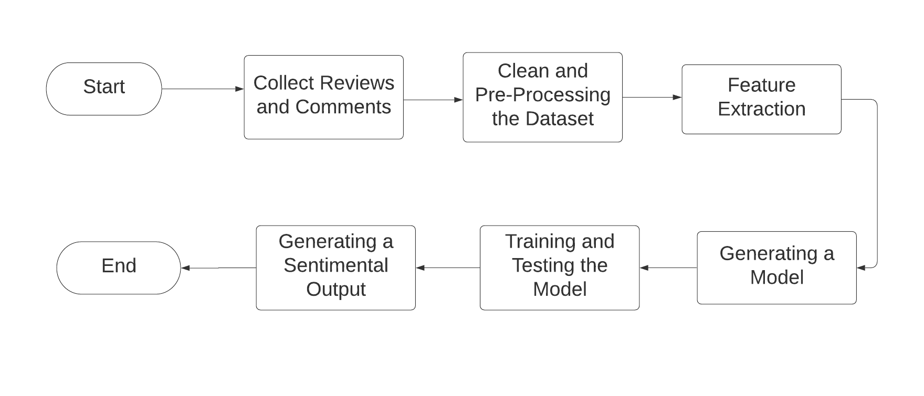
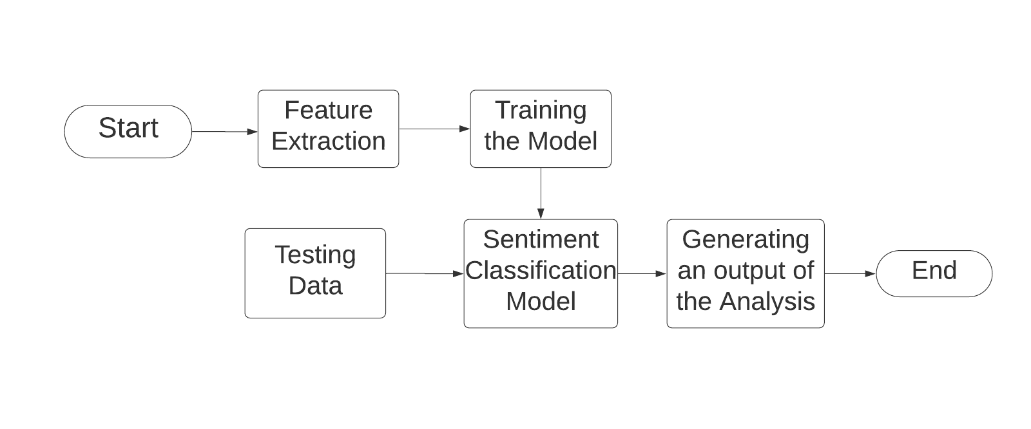
Proposed Methodology
Figure: System architecture
Figure: Building the Model

Slide 10
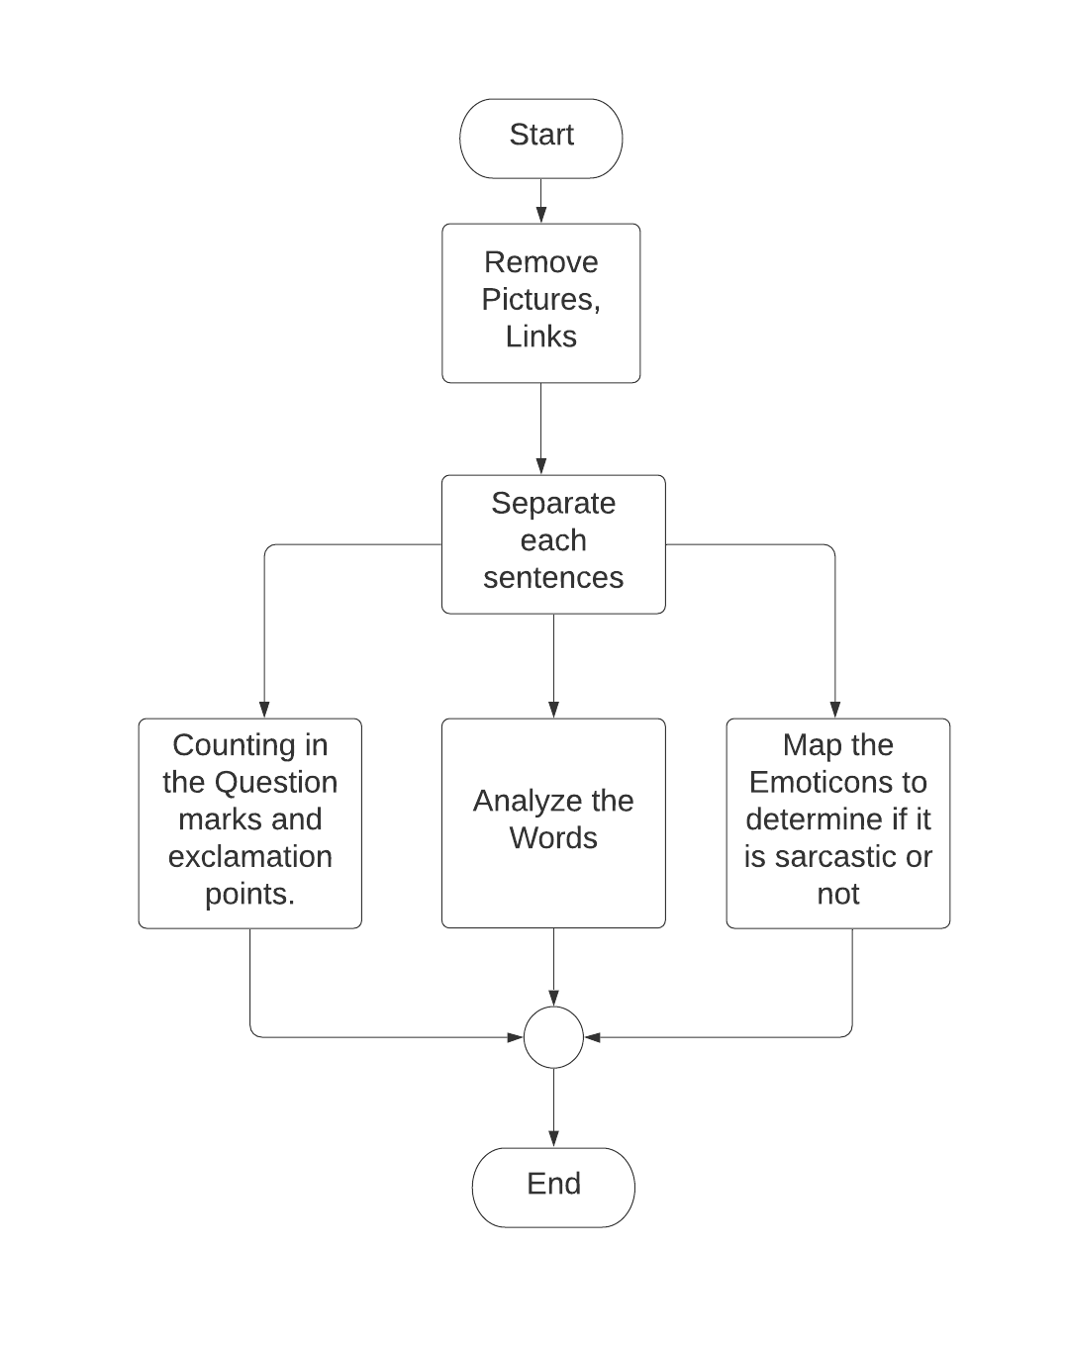
Proposed Methodology Cont.
Figure: Pre-Processing Flowchart

Slide 11
Conclusion
New buyers can easily get information about a specific product
Ratings can help the buyer to determine if the seller is fraud or not
Sellers can make changes in services to improve rating

Slide 12
Reference
[1] R. S. Jagdale, V. S. Shirsat and S. N. Deshmukh, ‘Sentiment analysis on product reviews using machine learning techniques,’ in Cognitive Informatics and Soft Computing, Springer, 2019, pp. 639–647
[2] L. Yang, Y. Li, J. Wang and R. S. Sherratt, ‘Sentiment analysis for ecommerce
product reviews in chinese based on sentiment lexicon and deep
learning,’ IEEE Access, vol. 8, pp. 23 522–23 530, 2020.
[3] B. S. Rintyarna, R. Sarno and C. Fatichah, ‘Semantic features for optimizing supervised approach of sentiment analysis on product reviews,’ Computers, vol. 8, 3 2019, issn: 2073431X.doi:10.3390/computers8030055.
[4] S. Xiao, H. Wang, Z. Ling, L. Wang and Z. Tang, ‘Sentiment analysis for
product reviews based on deep learning,’ in Journal of Physics: Conference
Series, IOP Publishing, vol. 1651, 2020, p. 012 103

Slide 13
THANK YOU

